Slide 1

Data Bootcamp
BIG DATA
Joseph Adler

Slide 2
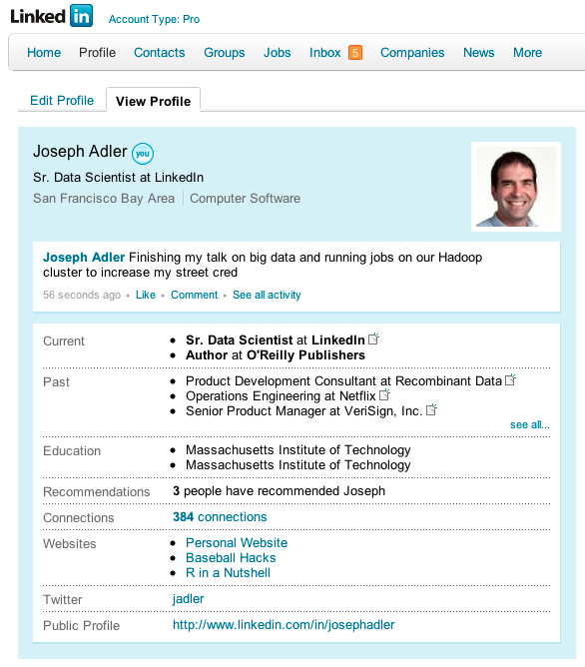
Who am I?

Slide 3




Who am I?
I’ve worked on big data problems at a number of different companies

Slide 4

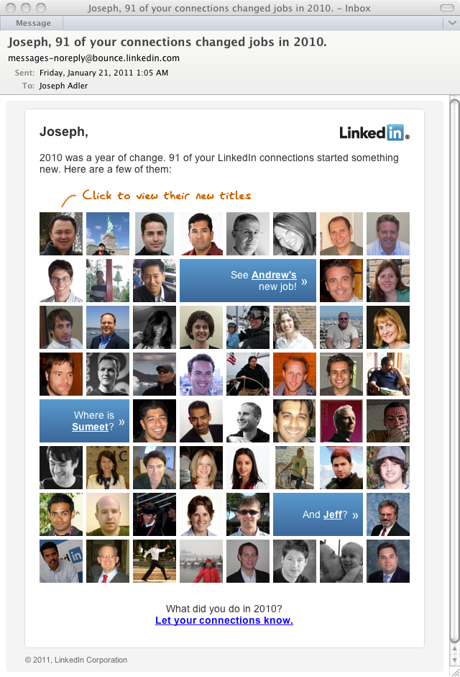


Who am I?
At LinkedIn, I built a system to let us send messages like this:
Using tools like this:
Azbakan
Voldemort

Slide 5
Tasks for today
Prerequisites
Math: Traditional and Bayesian statistics, supervised and unsupervised learning models, Algebra, Topology, Algebraic Topology
Computer system: Computer architecture, networks, compilers
Theoretical Computer Science: Serial and Parallel Algorithms, Complexity Theory
Working knowledge of Java, Python, and SQL; ability to learn 3-4 other languages
In the next hour, we will
Install and configure Apache Hadoop, Pig, Mahout, and Whirr
Spin up a cluster on Amazon Web Services with 128 nodes
Download example data: 37 series of cancer data from NIH Gene Expression Omnibus Database
Write a Java Map/Reduce task to load the microarray and phenotype data using Hadoop
Write a task in Pig to clean, normalize, and reformat the 37 different data sets
Write a Mahout job to fit a survival model using boosting
Tune configuration parameters to get the task to perform adequately given the machines’ memory, network, and storage characteristics
Download summary statistics on model performance and analyze with R
Cure cancer, heart disease, obesity, high blood pressure, and other diseases

Slide 6
Introduction
There isn’t a single “silver bullet” that will magically let you solve any size problem
Here are tips and tricks that I’ve learned from 15 years of experience working with data
Notes:
After first bullet “Not even Hadoop.”

Slide 7
Introduction
Q: When is data size a problem?
A: When you can’t analyze your data with the resources that you have
Try small data techniques first
It’s hard to work with big data techniques
Don’t optimize until you have to
Notes:
That might mean that you get “out of memory errors” or that your job never finished or that it took 7 days to process one day of data

Slide 8
Introduction
What do you do if you have too much data?
Shrink your data
Grow your computer
Find a smarter solution
Notes:
Side note:
Today, I am doing a scientific test to see how effective cheesy clip art is at capturing my audience’s attention.
I will also remind you that “Make People Fall In Love With Your Data: A Practical Tutorial for Data Visualization and UI Design” was in Mission City B4 this morning. This isn’t the presentation on making things pretty.

Slide 9
Shrink your data
What makes data too big?
Too wide
Variables that you don’t use
Redundancy
Inefficiently stored data
Too tall
Observations you don’t use
More observations than you need

Slide 10
Shrink your data
Suppose your data is just a little too big, and you need to shrink it a little (maybe 10-90%). Here are some easy things to try:
Data compression
More efficient data representation
Remove superfluous/redundant data

Slide 11
Shrink your data
Suppose that your data is way too big for your computer (say, 10x or more). Sampling may be a good way to reduce your data.

Slide 12
Shrink your data
How big a sample do you need?
Use power tests to estimate an adequate sample size
Example:
Suppose that you have an e-commerce web site, and you are optimizing the purchase process for widgets.
Currently, the process gets a 5% conversion rate.
If you implement a change to improve this rate, how much data do you need to be confident that the change is statistically significant?

Slide 13
Shrink your data
Example using R:
At a 95% confidence level and 5% power, how many observations do you need to be confident that an improvement of 20% is statistically significant?
> power.prop.test(p1=.05,p2=.06,sig.level=.05,power=.95)
Two-sample comparison of proportions power calculation
n = 13505.04
p1 = 0.05
p2 = 0.06
sig.level = 0.05
power = 0.95
alternative = two.sided
NOTE: n is number in *each* group

Slide 14
Shrink your data
Cluster Sampling
Example:
Suppose that you run an e-commerce web site.
You want to estimate the likelihood that a user will complete a purchase given the page that the user is visiting.
You have a database with a record for each page viewed by a user.
The database is too big for your software.
Notes:
Add recommendations: “sample users, not views” for first one

Slide 15
Shrink your data
Cluster Sampling
Example (continued)…
If you sample by randomly choosing rows from the database, you may lose important information on the sequence of pages that each user traverses
Instead, you can randomly select users then choose all rows for these users

Slide 16
Shrink your data
Stratified Sampling
Example
Suppose that you are looking for incidents of fraud in a database of credit transactions.
Fraud occurs rarely (only 1 in 5000 transactions)
The database contains 100,000,000 rows and has 50 columns
Your analysis software can only handle 1,000,000 rows

Slide 17
Shrink your data
Stratified Sampling
Example (continued)
Suppose that you take a random sample of 1,000,000 rows. What is the expected number of fraudulent observations?
Answer: 200
How do you sample the data to get more observations?

Slide 18
Shrink your data
Stratified Sampling
Idea: split the input data into categories, and sample from each category at a different rate
Example (continued):
Select all incidents of credit fraud, and 1% of other data
The final data set contains 20,000 incidents of fraud and 998,000 legitimate transactions

Slide 19
Grow your computer
If your data is too big (say, 2x to 5x) and you can’t shrink it, the easiest solution might be to buy more hardware.
Add more memory
Buy a faster machine
Switch to faster storage
Move to the cloud (or move to a bigger instance in the cloud)
Notes:
----- Meeting Notes (1/27/11 12:49) -----
Faster disks, more disks

Slide 20
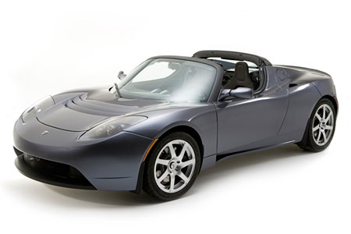
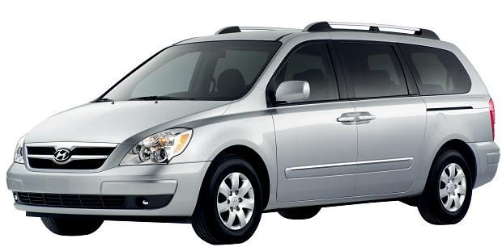
Grow your computer
If your data won’t fit in your computer’s memory, and you need to randomly access data, use a SQL database.
(SQL databases are like minivans. Neither of them are cool, but they’re both practical solutions to problems.)
NOSQL Database
SQL Database

Slide 21
Grow your computer
Good things about using databases for analysis
You can store more data than fits in memory
You can choose from fast, stable, mature products (many of them free)
Random access can be fast if you index your data
Aggregation can be fast if you use a column oriented database
You can do complex analytics (including machine learning) inside your database
It’s easy to describe many common problems in SQL

Slide 22
Grow your computer
Bad things about using databases for analysis
If you want to access data quickly, you need indexes
Indexes can get very, very large
Indexes can be expensive to maintain
SQL is a high level programming language
SQL optimizers don’t always find the most efficient way to solve a problem
If you’re using a non-SQL language to program your database, why bother using a database?

Slide 23
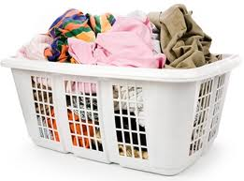
Grow your computer
The most scalable way to deal with big data problems is through parallel computing.
The classic example:
You have four loads of laundry, a mix of whites, colors, towels, and delicates. What’s the fastest way to clean everything?
Notes:
And yes, you might be able to do that with your database. Oracle has had parallel execution for over a decade.

Slide 24
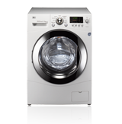
Grow your computer
Serial solution
You have one washing machine and dryer, maybe one of those funky European models.
It takes 2 hours per washer/dryer cycle
That means it takes 8 hours to finish your laundry

Slide 25


Grow your computer
Pipelining
You have one washer and one dryer
It takes 1 hours per wash, 1 hours to dry
Here the plan: start one wash. When it’s done, move it to the dryer. Start another wash.
This is called pipelining. It takes 5 hours to finish
Washer
Dryer

Slide 26
Grow your computer
Parallel Systems
You have 4 washers and 4 dryers
Here’s the plan: you wash the four loads at the same time then dry them at the same time. The whole wash takes 2 hours to finish.
Map/Reduce is a special case of a parallel solution
Washer
Dryer
Washer
Dryer
Washer
Dryer
Washer
Dryer
Notes:
----- Meeting Notes (1/27/11 12:49) -----
Visual for map/reduce
Need another diagram

Slide 27
Grow your computer
Map/Reduce
Example:
Suppose that you have a system that sends millions of email messages every day.
There are millions of transactions records for this system, capturing every message sent and every click on a message
Your goal is to count the number of sends and clicks by send date and message type.

Slide 28
Grow your computer
Map/Reduce
Example continued
Map step:
Process log files to extract keys. Key will be <date,event type,message type>
Shuffle
Move data between nodes, so all records with the same key (<date,event type,message type>) are sent to the same node
Reduce
Count the number of records for each key
Notes:
Some notes about the example:
I’ve written a job that does this. It runs every morning at 8:00 and emails me results.
Very little communication is required between nodes. Each of the steps can be run indendently

Slide 29
Grow your computer
Map/Reduce matters for two reasons
It’s a good paradigm for thinking about data problems
There’s a very good open source system for running problems with Map/Reduce: Apache Hadoop

Slide 30


Grow your computer
What is ?
A system for running jobs on a cluster of commodity servers.
A distributed file system that stores files on commodity servers.
Notes:
And if you want to learn more about Hadoop, there are plenty of other talks at Strata.

Slide 31
Grow your computer
When should you consider Hadoop?
Your problem is “Embarrassingly Parallel”
You have a cluster available
You need low level control over data processing
Notes:
----- Meeting Notes (1/27/11 12:49) -----
Thinking about dropping this

Slide 32
Smarter Solutions
Smarter solutions
Solve a different problem
Search the literature (well, Google) for ideas
Build your own tools

Slide 33
Smarter Solutions
Solving a different problem
If the problem you’re trying to tackle is too computationally intensive, look for something simpler and easier
Example
Suppose that you want to summarize a gigantic data set (say 100 TB of data) with 100 different variables
How do you efficiently compute summary the median of all 100 variables?
You don’t: you computer the average!

Slide 34
Smarter solutions
Searching the literature
Example: Streaming algorithms for Linear regresssion
Model form As input, you have a matrix X of predictors and a vector y of response variables. We are trying to find a vector of coeffecient c that minimizes the residual sum of squares:
How do you efficiently estimate c?

Slide 35
Smarter solutions
The standard way to find the linear regression coefficients: QR decomposition
QR decomposition transforms X into an orthogonal matrix Q and an upper triangular matrix R where X=QR, then calculates c=R⁻¹Q^{T}Y
The Gram-Schmidt method for QR decomposition requires O(n³) calculations, but more importantly requires data to be in memory

Slide 36
Smarter solutions
But you don’t have to store all the data in memory: you can use Alan Miller’s algorithm, which requires only O(p²) space for p variables.
From the article:
“The basic algorithm is the same as Gentleman's. As each new case is added, the orthogonal reduction is updated. In traditional least-squares notation, the algorithm goes straight from the X-matrix (the 'design' matrix) to the Cholesky factorization WITHOUT the intermediate step of forming a sum of squares and products matrix. Thus it avoids squaring the condition number. To be pedantic, it is actually the Banachiewicz factorization which is used.”
The biglm package in R uses this algorithm
References: http://lib.stat.cmu.edu/apstat/75, http://lib.stat.cmu.edu/apstat/274,

Slide 37
Smarter solutions
Writing your own tools
Example: Tagging with IP Geolocation
Suppose that you are interested in where botnets are concentrated
You have a database of security related incidents: firewall logs, intrusion detection system logs, and spam records
You also have a database with ranges of IP addresses
How do you tag the data with location?

Slide 38
Smarter solutions
Naïve solution:
SELECT e.*, l.* FROM security_events e, ip_geolocation l WHERE
e.ip >= l.ip_range_lower_bound AND e.ip <= l.ip_range_upper_bound

Slide 39
Smarter solutions
What’s wrong with the naïve solution:
Most databases aren’t designed with this case in mind (and when I looked for a solution in 2005, I couldn’t find a good solution)
Suppose that there are n_{e} observations in the events table and n_{l} observations in the location table
This query would take O(n_{e *} n_{l}) calculations.

Slide 40
Smarter solutions
My solution
If we sorted both the events and location tables (complexity: O(n_{e}log n_{e}) + O(n_{l}log n_{l}) we could merge the two tables in linear time (complexity: O(n_{e} + n_{l})).
I sorted the two input tables, then wrote a PL/SQL routine on Oracle to merge the two tables together

Slide 41
Privacy and legal issues
Privacy and legal issues
Fifteen years in data boils down to one thing: Don’t do anything that you wouldn’t be proud to read about on the front page of the New York Times.
Notes:
Or USA Today. That actually happened to me

Slide 42
Privacy and legal issues
Are you collecting data about people? Ask your attorney about
Video Privacy Protection Act http://en.wikipedia.org/wiki/Video_Privacy_Protection_Act
FCRA http://en.wikipedia.org/wiki/Fair_Credit_Reporting_Act
HIPPA http://en.wikipedia.org/wiki/HIPPA
HITECH http://en.wikipedia.org/wiki/HIPAA#HITECH_Act_security-breach_notification_requirements
Gramm-Leach-Biley http://www.ftc.gov/privacy/glbact/glbsub1.htm
EU Data Protection Directive http://en.wikipedia.org/wiki/Data_Protection_Directive
Plus any state laws that might apply…

Slide 43

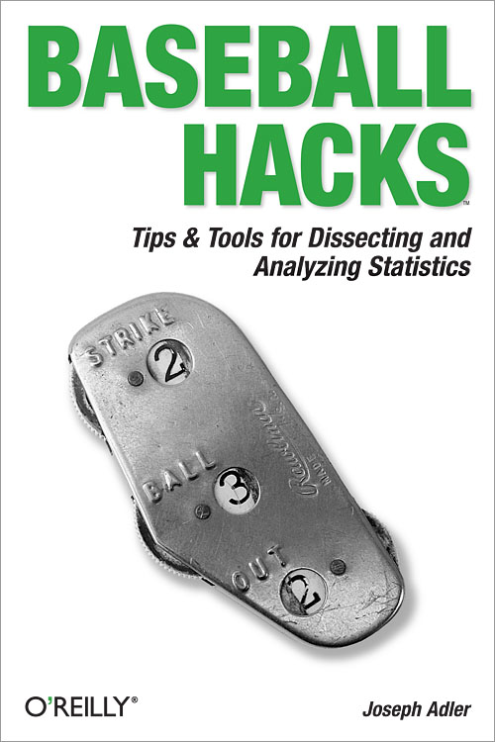
I like exclamation points!
Buy my books!
Follow me on Twitter! @jadler
Find me on LinkedIn! http://www.linkedin.com/in/josephadler

Slide 44
Appendix
More resource on Big Data

Slide 45


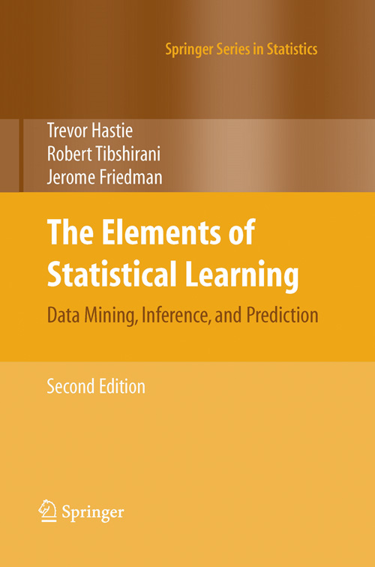
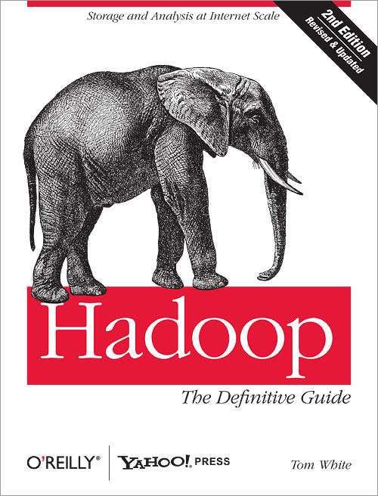
Books
A few books you should own

Slide 46
Courses
Some courses you may find useful
Cloudera training
http://www.cloudera.com/hadoop-training/
Statistical learning and data mining course
http://www-stat.stanford.edu/~tibs/ElemStatLearn/

Slide 47
Books to download
Books you can download
Elements of statistical learning: http://www-stat.stanford.edu/~tibs/ElemStatLearn/
Mining of Massive Data Sets http://i.stanford.edu/~ullman/mmds.html

Slide 48
Papers to read
Papers you should read:
MAD Skills (in database statistics with procedural SQL): http://db.cs.berkeley.edu/jmh/papers/madskills-032009.pdf
Google’s Map/Reduce Paper: http://labs.google.com/papers/mapreduce.html

Slide 49
People to follow
People I follow (on Twitter)
Jeff Hammerbacher @hackingdata
Pete Skomoroch @peteskomoroch
Michael E Drischool @medriscoll
Nathan Marz @nathanmarz
Drew Conway @drewconway
Bradford Cross @bradfordcross
Hilary Mason @hmason
Kevin Weil @kevinweil
Chris Wensel @cwensel
DJ Patil @dpatil
Ben Lorica @bigdata
LinkedIn SNA Projects @snaprojects
Jake Hoffman @jakehoffman
Me @jadler

Slide 50
Blogs to read
Blogs you should read
http://blog.okcupid.com/
http://flowingdata.com/
http://sna-projects.com/blog/
http://measuringmeasures.com/
http://www.dataists.com/
http://www.cpdiehl.org/blog.html
http://www.facebook.com/Engineering
http://benfry.com/writing/
http://www.stat.columbia.edu/~gelman/blog/
http://databasecolumn.vertica.com/
http://hunch.net/
For more ideas, see www.quora.com/What-are-the-best-blogs-about-data?q=data+blogs)

